Slide 1
Introduction to Cyber Crime and Cyber Forensics

Slide 2
Introduction to Cyber Crime
Cyber Crime
Cyber crime is defined as criminal activity involving the IT infrastructure, including illegal access, illegal interception, data interference, misuse of devices, ID theft and electronic fraud.
Thus if a computer(Digital Device) is used to conduct a crime it is a cyber crime.
Also if a computer is a victim (Target) of a crime it will be a cyber crime.
Today there is a huge rise in the amount of the cyber crimes that take place.

Slide 3
Introduction to Cyber Crime
“Computers are a poor man’s weapon.”
Richard Clarke- Special Advisor to the U.S. President on Cyberspace Security.
Cyber crime can also be defined as “Unlawful acts wherein the computer is either a tool or a target or both.”

Slide 4
Introduction to Cyber Crime
Some Examples of Cyber Crime
Financial Cyber Crimes- Cheating, Credit Card frauds, money laundering etc.
Sometimes fake websites are created, which pose to provide goods at a low cost but in reality their main aim is to collect credit card information.
Fishing emails posing as sent by banks are sent asking users to click the link and update their net banking information. In fact the link takes the customer to a fake replica website of that bank. When user gives it’s username and password it is captured. This is used by criminals to withdraw money from that account

Slide 5
Introduction to Cyber Crime
Sale of illegal items – sale of drugs, banned chemicals, weapons, wildlife etc.
Specific(code) names are used for these items.
Advertisements are posted on websites or on auction sites. Also blogs or bulletin boards are used to publicize these items. Even social networking sites and email communication is used for spreading information about these items.
It was found by police that for all recent Rave parties social networking sites were used to advertise the event. Drug selling is the main aim of such parties.

Slide 6
Introduction to Cyber Crime
Intellectual Property Crimes- Software piracy, copyright infringement, theft of source code, trademark violation.
Cyber Defamation- creating fake profile of a person on social networking site to deface him/her, sending emails by a person name to all his/her friend and relatives containing vulgar things to deface him/her. Sharing forged pictures or clips by MMS/SMS or using web sites to deface a person.
Forgery – creating counterfeit university Degree certificates, Mark sheets, stamp papers, currency notes etc. using computers, high end scanners and printers.

Slide 7
Introduction to Cyber Crime
Email Spoofing- Sending emails such that for receiver it appears as if it send by an authorized source.
Online Gambling- some countries like India have ban on gambling. Most of the time these sites are used for money laundering.

Slide 8
Introduction to Cyber Crime
Unauthorized access to computers and networks.
Unauthorized copying of data from computer systems using CD/DVD or pen drives.
Sending large amount of emails to someone to block his account or sometimes to crash the email server.
Causing Denial Of Service attack by sending huge amount of fake requests to a web server so that the valid users do not get access to the web site.
Creating and spreading viruses, worms, spywares and root kits etc.
Physically damaging computers, equipments or networks.

Slide 9
Introduction to Digital Evidence
Any information that is stored electronically is said to be in Digital format.
This is because it is stored in the form of digits i.e. zero(0) and One (1) , the Binary format.
Any data like documents, photographs and video clips etc. are stored in this format.
When this information is used as an evidence legally to prove a crime, it is called Digital Evidence.
Digital Evidence may come into use in various crimes like murder, rapes, suicides, child abuse, theft etc.
Computer documents, emails, web posts, internet browsing history, transaction logs, MMS/SMS, etc. can be used as Digital Evidence.

Slide 10
Introduction to Digital Evidence
It is any or all digital data that can establish that a crime has been committed or can provide a link between a crime and its performer or a crime and its victim.
This is an information and data of value to an investigation that is stored on, received or transmitted by an electronic device.
The digital evidence is mostly hidden, crosses jurisdictional boundaries quickly and easily, can be time sensitive, can be easily altered, destroyed or damaged with little efforts.

Slide 11
Introduction to Digital Evidence
Today digital evidence plays an important role in conventional crime investigation.
The victim or criminal CCTV recordings, mobile call records, GPRS tracking of their locations etc. are used to link them to the crime.
The Indian Parliament in 2000 enacted the Information Technology (IT) Act 2000.
This Act amended the Indian Evidence Act 1872, the Indian Penal Code 1860 and the Banker’s Book Evidence Act 1891.
This amendment allows these Acts to consider Digital Evidence.

Slide 12
Introduction to Digital Evidence
Sec. 2(1) (t) Defining Electronic Record
"Electronic record" means data, record or data generated, image or sound stored, received or sent in an electronic form or micro film or computer generated micro fiche.
The section has made electronic record legally admissible in the court of law.
Sec. 3 (a) – Scope of definition of evidence expanded to include electronic records.
Sec. 65B – Admissibility of electronic records

Slide 13
Introduction to Digital Evidence
As the Cyber Crimes are mostly carried by using computers and internets Digital Evidence is of most important.
It is very important that the Digital Evidence is prepared properly.
A proper procedure is required so that the Digital Evidence is trusted by the courts.
As some Digital Evidence can be fragile/volatile due care has to be taken to protect it.
A person who performs Digital Forensics needs to be professional with proper knowledge of Digital technologies.

Slide 14
The Rules of Evidence
The rules of evidence are guidelines that determine how evidence should be handled.
These guidelines take many things into consideration like what evidence is admissible, when it is admissible, and who is entitled to present it.
There is no universal set of rules of evidence.
A court may also have its own set of rules.
This means that evidence may be handled differently in a criminal case than it is in a civil case within the same state.
They were put into place to regulate the portion of the trial process that pertains to evidence so that proceedings can be fair for all involved.

Slide 15
The Rules of Evidence
Rules of evidence also can be used to assist the judge.
The judge has to weigh the evidence to make a final determination.
If there are not rules that outline what evidence can be presented at what time and by whom, the duties of these individuals could become laborious and complicated.
The best interest of the parties may be affected and justice may not be served.
Three factors that commonly are used to determine admissibility are whether the potential evidence is material, relevant, and competent.
Rules of evidence deal with many issues involving witnesses.

Slide 16
The Rules of Evidence
Thus it is very much important for a forensic expert to know about the rules of evidence.
It will make his job easier as he will capture the evidences which are admissible in the court.
As there is no universal rule of evidence, each time a forensics expert start his work he needs to know the rules of evidence in that area.
Thus it makes the job of a cyber forensics difficult as the cyber crime may involve multiple courts or areas and thus may have different rules of evidence applicable.

Slide 17
Locard’s Exchange Principle
Dr. Edmond Locard (13 December 1877 – 4 May 1966) was a pioneer in forensic science.
He put forward a concept “When there is a contact between two items there will an exchange” OR “Every contact leaves a trace”.
Locard believed that no matter where a criminal goes or what a criminal does, he will leave something at the scene of the crime.
At the same time, he will also take something back with him.
Locard successfully used this principle while working as forensic expert on many cases and solved them.

Slide 18
Locard’s Exchange Principle
Wherever he steps, whatever he touches, whatever he leaves, even unconsciously, will serve as a silent witness against him.
Not only his fingerprints or his footprints, but his hair, the fibers from his clothes, the glass he breaks, the tool mark he leaves, the paint he scratches, the blood he deposits or collects.
All of these and more, bear mute witness against him. This is evidence that does not forget. It is not confused by the excitement of the moment.

Slide 19
Locard’s Exchange Principle
It is not absent because human witnesses are.
It is factual evidence.
Physical evidence cannot be wrong, it cannot perjure itself, it cannot be wholly absent.
Only human failure to find it, study and understand it, can diminish its value."

Slide 20
Why is Computer Forensics necessary?
Today is the age of IT.
Every individual or organizations use computers to store valuable information or to perform commercial transactions.
Today the rate of cyber crime is increased and the organizations or individuals suffer a great monetary loss due to this.
Thus in order to prosecute such crimes, evidence must first be gathered both:
in sufficient quantity to substantiate any criminal or civil charges, and handled properly so that the evidence will hold up in court.

Slide 21
Why is Computer Forensics necessary?
However as much of this evidence will be in digital format the ability to extract the relevant digital evidence in a manner that preserves the value and integrity of the data is critical.
This is the reason we need a careful, methodical process for gathering digital data in the first place ; and this is why we need computer forensics.
But handling digital evidence differs in many ways from handling physical evidence and an investigator must know:
Where to look for digital evidence
The proper way to acquire this evidence
How to handle and preserve this evidence in such a manner that preserves its probative value

Slide 22
Computer Forensics
This concept was firstly defined in 2001 by the Digital Forensics Research Workshop (DFRWS) as “The use of scientifically derived and proven methods toward the preservation, collection, validation, identification, analysis, interpretation, documentation and presentation of digital evidence derived from digital sources for the purpose of facilitating or furthering the reconstruction of events found to be criminal or helping to anticipate unauthorized actions shown to be disruptive to planned operations”

Slide 23
Cyber Forensics and Incident Response Plan
Incident response is about planning for the unexpected or undesirable events
The incident response plan (IRP) is the document that contains procedures to follow in case of an emergency.
Organization must have sufficient detection & monitoring capabilities to detect incidents in a timely manner.
Thus timely detection of an incident and proper action against it will make sure that the incident causes negligible or no damage to an organization.

Slide 24
Cyber Forensics and Incident Response Plan
However when an incident happens like a virus attack or a network intrusion following questions require answers.
How the attack happened?
Who was involved?
What was the reason for the attack?
Where did attack originate from?
When did the initial attack occur?
How did it happen?
What vulnerability enabled the attack?
Also an organization may want to take legal action against the initiator of the attack.
Thus cyber forensics team is required.

Slide 25
Module 2 Basic Forensics principle

Slide 26
Principles of Cyber Forensics
The four main principles of cyber forensics are
1. No action should change data held on a computer or storage media which may be subsequently relied upon in court.
2. In circumstances where a person finds it necessary to access original data held on a computer or storage media, that person must be competent to do so and be able to give evidence explaining the relevance and the implications of their actions.

Slide 27
Principles of Cyber Forensics
The four main principles of cyber forensics are
3. An audit trail or other record of all processes applied to computer-based electronic evidence should be created and preserved. An independent third-party should be able to examine those processes and achieve the same result.
4. The person in charge of the investigation has overall responsibility for ensuring that the law and these principles are adhered to.

Slide 28
Principles of Cyber Forensics
However, sometimes it is not possible or desirable to switch a computer off.
It may not be desirable if doing so would mean that potentially valuable evidence may be lost or may cause the owner a great financial loss.
In both these circumstances the computer forensic examiner would need to carry out a ‘live acquisition’ which would involve running a small program on the suspect computer in order to copy (or acquire) the data to the examiner’s hard drive.

Slide 29
Principles of Cyber Forensics
By running such a program and attaching a destination drive to the suspect computer, the examiner will make changes and/or additions to the state of the computer which were not present before his actions.
Such actions would remain admissible as long as the examiner recorded their actions, was aware of their impact and was able to explain them.

Slide 30
Chain of Custody
A chain of custody is a procedure that shows how evidence was collected, analyzed, and preserved in order to be presented as evidence in court.
Establishing a clear chain of custody is crucial because electronic evidence can be easily altered.
A clear chain of custody demonstrates that electronic evidence is trustworthy.
Preserving a chain of custody for electronic evidence, at a minimum, requires proving that:
No information has been added or changed
A complete copy was made
A reliable copying process was used
All media was secured^{[v]}

Slide 31
Chain of Custody
Proving this chain is unbroken is a prosecutor’s primary tool in authenticating electronic evidence.
The Chain of Custody is very crucial as during the evidence collection phase the digital media may undergo various processes.
Also sometimes to gather evidences different experts may require to handle the digital media.
Thus it is very important to keep track of everything i.e. who handled the media, for what purpose, tools used etc.
This proves the integrity of the evidences.

Slide 32
Methodology of Cyber Forensics
There is a basic, inherent process to computer forensics.
As in any discipline, computer forensics analysts or specialists will follow clear, well defined methodologies and procedures, and flexibility is expected and encouraged when encountering with the unusual.
The basic methodology consists of
1. Acquire the evidence without altering or damaging the source.
2. Authenticate that the recovered evidence is the same as in the seized source.
3. Analyze the data without altering it.

Slide 33
Methodology of Cyber Forensics
The process of Computer Forensics can be outlined as follows…
Identification Phase
Acquisition of Evidence
Authentication of Evidence
Analysis of gathered Evidence
Presentation of Evidence
However sometimes it is required to come back to earlier stage or phase, as in later phases it may become necessary to include more data sources.

Slide 34
General Evidence processing Guidelines and Procedures
Computer evidence is fragile by its very nature and the problem is compounded by the potential for destructive programs and hidden data.
Even the normal operation of a computer can destroy computer evidence that might be present in temporary operating system files, temporary application working files and working data storage areas.
Thus it is not enough to run a computer forensics program and get results.
Good decisions are to be made by knowledgeable individuals who understand the underlying technical issues tied to the potential security risks and evidence processing issues tied to personal computers.

Slide 35
General Evidence processing Guidelines and Procedures
There are no strict rules that must be followed concerning the processing of computer evidence.
Every case is different and flexibility and good technical knowledge make the difference between success and failure.
However, many times decisions need to be made without full the knowledge of the issues involved.
This where the guidelines come in picture.
They help you in take immediate decisions regarding the digital evidence capture process.

Slide 36
General Evidence processing Guidelines and Procedures
If the computer needs shutdown?
What about volatile data?
Running configuration information like cookies, sessions, cached data etc. needs to be considered
Is logic bomb running in the background?
Which forensic tool to use?
Whether to shutdown the system using OS commands or simply pull the plug( preferred )?
Transport the computer system securely to a safe place.
Make sure the transportation is safe… else may damage parts like Hard Disk / CD-DVD etc.
Decide who can access it and record all handlings

Slide 37
General Evidence processing Guidelines and Procedures
Make Bit-Stream backup of all digital media
Make duplicate copies of all Hard disks, CD-DVD, Pen Drives, SD cards, Floppies etc.
Use some hash algorithm to prove that the copy is exact replica of the original and no alterations made to original because of this duplicating.
Always work on the restored duplicate copy.
Document each every thing you do.
Create search filters
The volume of data you have will be very high.
Searching all data is not possible, thus identify the words, filenames that are related to the crime.
Search for this data only.

Slide 38
General Evidence processing Guidelines and Procedures
Check for the deleted data
The evidence may be deleted by the culprit.
Use good forensics data recovery tools to find deleted data.
Document the entire process
Check for hidden data
Attacker may take advantage of some file system features like NTFS data streams to hide data.
Use special tools to check for these kind of data
Document all programs found on the system.
Some hacking tools installed?
Some data destroying tools installed?

Slide 39
General Evidence processing Guidelines and Procedures
Record time stamps for all files.
Creation date
Last Modified date
Find as much information as possible
Take electronic snapshot of files and data.
Make an electronic copy of the files or data to be used as evidence.
Document everything about this data like location, tools used to recover and copy etc.
Document your findings

Slide 40
Module 3 General Computing Principles

Slide 41
Storage Basics
With magnetic media, such as floppy discs, data is stored magnetically
The data (0s and 1s) is represented using different magnetic alignments
Optical media (such as CDs and DVDs) store data optically using laser beams
Data can be permanently burned on the disc
Rewritable optical media can be erased and rewritten
Magnetic tape: Plastic tape with a magnetizable surface that stores data as a series of magnetic spots

Slide 42
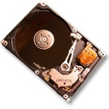
Storage….. Hard Disk Basics

Slide 43
Hard Disk Basics
Hard disks have a metal platter that holds the magnetic medium, as opposed to the flexible plastic film found in tapes and floppies.
In a hard disk, the magnetic recording material is layered onto a high-precision aluminum or glass disk. The hard-disk platter is then polished to mirror-type smoothness.

Slide 44
Hard Disk Basics
There are two ways to measure the performance of a hard disk:
Data rate - The data rate is the number of bytes per second that the drive can deliver to the CPU. Rates between 5 and 40 megabytes per second are common.
Seek time - The seek time is the amount of time between when the CPU requests a file and when the first byte of the file is sent to the CPU. Times between 10 and 20 milliseconds are common.

Slide 45
Hard Disk Basics
The other important parameter is the capacity of the drive, which is the number of bytes it can hold.
Normally the capacity of the drive is measured in Gigabyte (GB).
E.g. 40 GB / 80 GB / 160GB /250GB

Slide 46
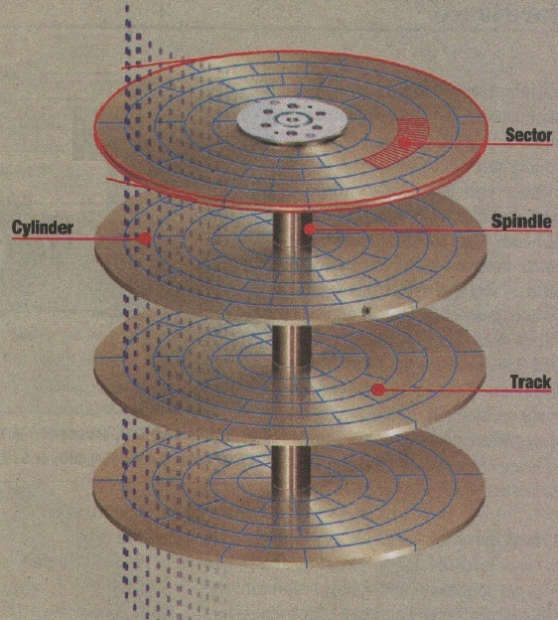
Heads, tracks, and Cylinders

Slide 47
Hard Disk Basics
The platters - These typically spin at 3,600 or 7,200 rpm when the drive is operating. These platters are manufactured to amazing tolerances and are mirror-smooth.
The arm - This holds the read/write heads and is controlled by the mechanism in the upper-left corner. The arm is able to move the heads from the hub to the edge of the drive. The arm and its movement mechanism are extremely light and fast. The arm on a typical hard-disk drive can move from hub to edge and back up to 50 times per second.
In order to increase the amount of information the drive can store, most hard disks have multiple platters.

Slide 48
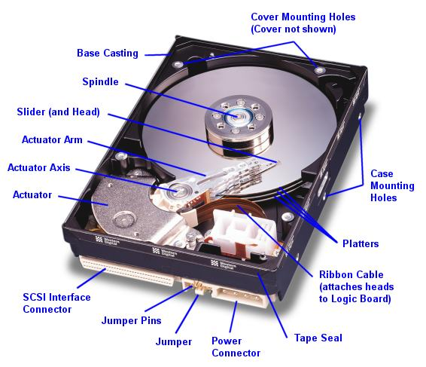

Slide 49
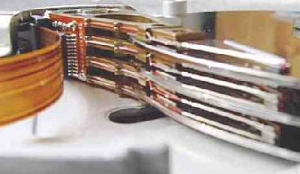
ARM
PLATER

Slide 50
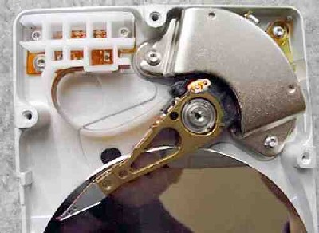
Many drives use a "voice coil" approach that moves the arms on a hard disk & has to be incredibly fast and precise.

Slide 51
Hard Disk Basics
The read/write heads do not touch the platters in the drive.
When the platters spin up, they rotate at anywhere between 3,600 rpm and 7,200 rpm.
To the head, the platter seems to be moving at about 150 mph, and a very thin cushion of air forms between the head and the platter so that the head "flies" over the platter.
If even the smallest bit of dust makes its way onto the platter, the flight is disrupted and the head "crashes" into the platter, scratching it. The crash, of course, sprays a lot more dust and debris onto the platter and then it's all over.

Slide 52
Hard Disk Basics
Magnetic storage stores data by magnetizing microscopic particles on the disk surface
Notes:
Figure 2-22

Slide 53
Hard Disk Basics
Data is stored on the surface of a platter in sectors and tracks.
Tracks are concentric circles, and sectors are pie-shaped wedges on a track.
A sector contains a fixed number of bytes -- for example, 256 or 512.
Either at the drive or the operating system level, sectors are often grouped together into clusters.

Slide 54
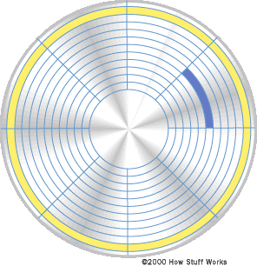
SECTOR
TRACK

Slide 55
Hard Disk Basics
The process of low-level formatting a drive establishes the tracks and sectors on the platter.
The starting and ending points of each sector are written onto the platter. This process prepares the drive to hold blocks of bytes.
A partition needs to be created on the hard disk.
High-level formatting then writes the file-storage structures, like the file-allocation table, into the sectors.
This process prepares the drive to hold files.

Slide 56
Hard Disk Interface
Determine how a drive connect to the PC and other characteristics
Common standards:
Parallel ATA (PATA)
Serial ATA (SATA) and serial ATA II (SATA II)
SCSI and the newer serial attached SCSI (SAS)
Fibre Channel
Fibre Channel over Ethernet (FCoE)
eSATA
External hard drives can also connect via USB or FireWire, but eSATA is closer in performance to internal hard drives

Slide 57
CD/DVD Storage Basics
Optical discs: store data optically (using laser beams) instead of magnetically
Divided into tracks and sectors like magnetic discs but use a single grooved spiral track
Can be read-only, recordable, or rewritable
Conventional CD discs use infrared lasers
DVDs use red lasers
High-definition DVDs use blue-violet lasers to store data more compactly
Burning: Recording data onto an optical disc
Pits and lands are used to represent 1s and 0s
Pits can be molded into the disc surface or created by changing the reflectivity of the disc
The transition between a pit and a land represents a 1; no transition represents a 0

Slide 58
CD/DVD Storage Basics
CDs and DVDs have a large capacity
Multiple layers and multiple sides can be used to increase capacity
Standard CD discs hold 650 MB to 700 MB
Standard DVD discs hold 4.7 GB (single-layer disc) or 8.5 GB (double-layer disc)
High definition DVDs hold up to 50 GB
Optical discs also have great durability
Do not degrade with use, but should be handled carefully

Slide 59
Small Storage Basics
Use flash memory media
No moving parts so more resistant to shock and vibration, require less power, makes no sound
Solid-state storage system
Most often found in the form of:
Flash memory cards
USB flash drives
Solid-state drives
Hybrid hard drives
Very small and so are very appropriate for use with digital cameras, digital music players, handheld PCs, notebook computers, smart phones, etc.

Slide 60
Storage Basics
Remote storage: Using a storage device not directly a part of the PC being used
Network storage: Accessible through a local network
Online storage: Accessed via the Internet
Backup
Transferring files to others or to another PC
Sharing files with others (online photo sites, etc.)
Network attached storage (NAS): High-performance storage server individually connected to a network to provide storage for computers on that network
Storage area network (SAN): Network of hard drives or other storage devices that provide storage for another network of computers

Slide 61
File System Basics
The data on storage devices is stored in 0’s and 1’s format.
Also the data on the storage devices is scattered, it means a single file is not stored continuously on the media.
Thus someone has to take care of this data i.e. keep track of data that goes on the media.
File system which is a part of the operating system, keeps records of the data goes on the media.
It stores other information about the file like filename, date and time file is created, attributes of files likes hidden, read only etc.

Slide 62
File System Basics
FAT- File Allocation Table
First introduced by Microsoft in 1976.
Various versions of FAT introduced later.
FAT16 and FAT32 being the most popularly used.
The FAT table stores filenames, Directory names, Access times, cluster numbers and attributes for the file like read only, hidden etc.
This table resides at the outermost area of the hard disk.

Slide 63
File System Basics
FAT- File Allocation Table
The FAT32 keeps a second copy of the table also to provide redundancy in case the first one fails.
This file system is supported by most of the today’s operating systems.
All most all digital storage media like pen drives, SD cards use FAT as the default file system.
The FAT32 supports a maximum volume size of 32GB.
The maximum file supported by FAT32 is 4GB.

Slide 64
File System Basics
NTFS- New Technology File System
It is a Microsoft designed File System.
It was introduced by Microsoft with Windows NT.
Today it is the default file system when you format a hard disk partition.
It uses Master File Table (MFT) instead of File Allocation Table(FAT).
It is the first file on the hard disk.
Records within the MFT are called Meta-Data.
It contains information about all files on the disk including the system files.

Slide 65
File System Basics
NTFS allows security attributes (ACL, Encryption) for files stored on the disk.
At format the MFT assigns the Logical Cluster Numbers to the entire disk partition.
These LCN’s allow OS to read/write data on the disk.
Each LCN is linked to a Virtual Cluster Number (VCN), that allows a file to grow beyond across the free disk space area of the hard drive.
The maximum volume size supported by NTFS in XP is approx. 256 Terabytes.
The maximum file size supported is of 16 Terabytes.

Slide 66
File System Basics
EXT2 File system
The Second Extended File system was devised (by Rémy Card) as an extensible and powerful file system for Linux.
It is also the most successful file system so far in the Linux community.
One problem that is commonly reported is that an ext2 file system must undergo a lengthy file system integrity check if the system was not cleanly shut down.

Slide 67
File System Basics
EXT3 File System
The ext3 file system builds upon ext2 by adding journaling capabilities.
As a journaling file system, ext3 always keeps the file system in a consistent state, eliminating the need for lengthy file system integrity checks.
This is accomplished by writing all file system changes to an on-disk journal, which is then flushed on a regular basis.
After an unexpected system event (such as a system crash or shutdown), the only operation that needs to take place is to process the contents of the journal and it takes very less time.

Slide 68
File System Basics-Swap File
The swap file is a hidden system file that is used for virtual memory when there is not enough RAM to run programs.
Space on the hard drive is temporarily used as RAM (Virtual Memory).
Program data is swapped between the RAM and the virtual memory as programs are running.
This swap file contains portions of all documents and other material a user produces while using the computer.
In Windows NT/XP systems, the swap file is named pagefile.sys; on older Windows 9X systems, it is named win386.swp.

Slide 69
File System Basics-Slack Space
Most OS today create a small amount of allocation unit normally 4K.
So for a file of 8K size two units are allocated, however for a file of 5K also two units are allocated.
Slack space results when file systems create a cluster (Windows) or block (Linux) but do not necessarily use the entire fixed length space that was allocated.
In this case, file information from previous use is still available, long after deletions and rewrites.
At the very least, viewing these clusters can prove to a forensic examiner that a certain type of file might have existed.
A significant advantage of NTFS is that it generates much less slack space.

Slide 70
File System Basics
When a user deletes a file the file system only updates the free block list.
The blocks used by the deleted file now appear in the free block list, however the data stored in the blocks is not deleted.
When you create a new file and save it on the hard disk, file system may allocate those blocks (earlier used by deleted file) to the new file and then the part of the earlier data is overwritten.
Thus the free blocks of a storage device may also contain the deleted data.

Slide 71
Memory Basics
Memory Unit
Memory unit is used to store the data and program. CPU can work with the information stored in memory unit. This memory unit is termed as primary memory or main memory module. These are basically semi conductor memories.
There ate two types of semiconductor memories -
Volatile Memory : RAM (Random Access Memory). Non-Volatile Memory : ROM (Read only Memory), PROM (Programmable ROM) ,EPROM (Erasable PROM), EEPROM (Electrically Erasable PROM).

Slide 72
Memory Basics
ROM – Read Only Memory - a type of memory that cannot be written, can only be read. Contents determined at manufacture time.
ROM is non-volatile – contents remain even when power is off.
PROM – Programmable ROM – a type of memory whose contents can be programmed by the user
OTP – One Time Programmable, a PROM is OTP if contents can be programmed only once.
EEPROM – Electrically Erasable PROM – contents be erased electrically by the user.
Memory is not alterable under ‘normal’ operation.

Slide 73
Memory Basics
RAM – Random Access Memory – memory that can be both read and written during normal operation.
Contents are volatile, will be lost on power off.
SRAM – static RAM – has the following characteristics:
Read, Write operations take equal amounts of time
Access to any ‘random’ location takes same amount of time.
Fastest access time of memory types.
Basic memory cell is a latch, takes 6 transistors per memory bit.
Dynamic RAM (DRAM) - one transistor + capacitor per bit!
Requires frequent refresh of stored data

Slide 74
Boot Process
To ensure that forensic data is not contaminated or altered, it is necessary most of the time to boot computer using bootable CDROM operating system.
Thus forensics expert needs to know how to open and set the suspicious computer’s CMOS and BIOS to boot from a CDROM.
The BIOS is stored inside the CMOS Chip.
The CMOS uses a small battery to store system configuration information, including the date and time, when the power is off.
The BIOS contains programs that include the instructions for input and output at the hardware level.
Sometimes a system may have a BIOS password to protect settings and booting .
Usually this can be reset by removing the CMOS battery.

Slide 75
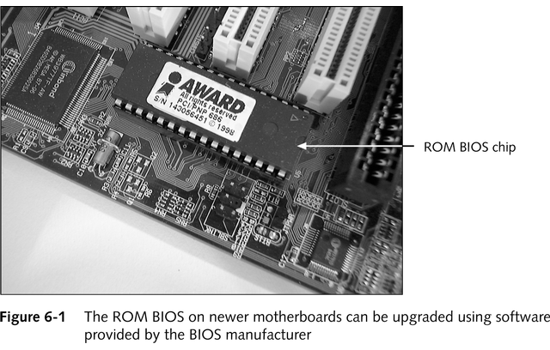
ROM on the Motherboard

Slide 76
Boot Process
The BIOS – A collection of programs embedded in one or more chips.
It is the first thing loaded when you start your computer.
The BIOS in most PCs performs four main functions:
-POST (power on self test).
POST tests your computer's processor, memory, chipset, video adapter, disk controllers, disk drives, keyboard, and other crucial components.
-Setup.
System configuration and setup program.
Usually menu driven.
Activated by pressing a special key during the POST and enabling configuration of motherboard and chipset settings and date and time,passwords, disk drives, and other basic settings.

Slide 77
Boot Process
-Bootstrap loader. Looks for a valid master boot record (MBR).
The master boot sector program continues the boot process loads an operating system boot sector, which loads the operating system core files.
-BIOS (basic input/output system).
A collection of actual drivers used to act as a basic interface between operating system and hardware when the system is booted and running.
The BIOS contains the Setup program which is used to set and store the configuration settings and these are maintained on the motherboard in a chip called the RTC/NVRAM chip (real-time clock/nonvolatile memory).

Slide 78
Booting up Your Computer
Refers to the computer bringing itself up to an operable state without user intervention
Hard boot (cold boot)
if you have a machine that is off (and cold), and you press the power button, it is a cold boot
More stressful than soft boot because of initial power surge through equipment
Soft boot (warm boot)
If you have a machine that is already running (it is warm) and you press the CTRL/ALT/DEL combination or select “RESTART”, this is a warm boot. Uses OS to reboot
Faster than hard boot. Watch to see the difference in the POST, because there are changes here too!

Slide 79
Booting up Your Computer
The startup process initiates a chain of events that eventually finds its way to you, the user.
Before you gain control, however, the computer’s CPU, peripheral hardware, low-level firmware (software stored in ROM that remains even if a PCs power is off) and ultimately its OS must work together to achieve a normal setup.
The BIOS is the conductor that ensures this combination of devices and code works together to generate a normal startup routine.

Slide 80
The Master Boot Record
In the final step of the boot process, we talked about the MBR
It is located on cylinder 0, head 0, sector 1 the very first sector on disk and it is used to store the location of the root directory and the OS loader routine.
Now you can see why a MBR virus can be so deadly!
Nimda acted like this, it would infect the MBR so if you formatted the hard drive, you might not get rid of the virus unless you did format /mbr as well.

Slide 81
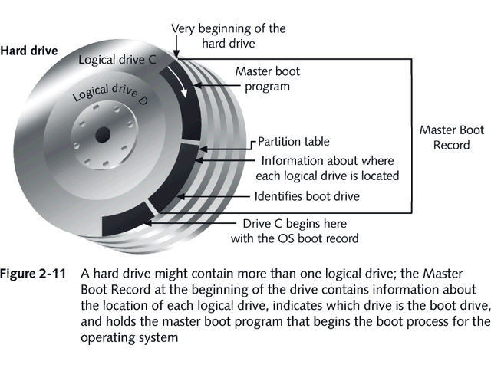
How BIOS Finds/Loads the OS

Slide 82
Parts of the Boot Process
Step 1: POST
Step 2: ROM BIOS startup program searches for and loads an OS
Step 3: OS configures the system and completes its own loading
Step 4: User executes application software

Slide 83
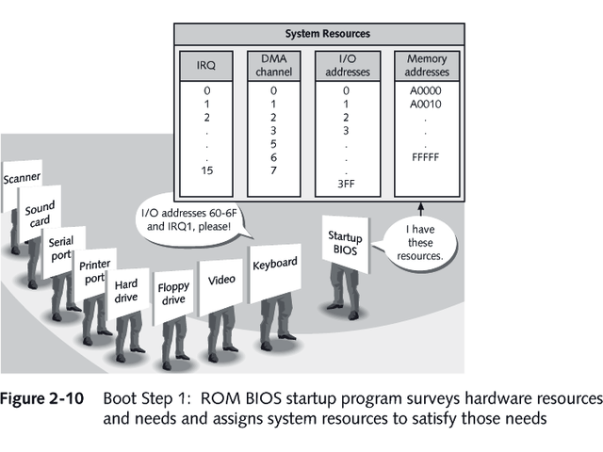
Boot Step 1

Slide 84
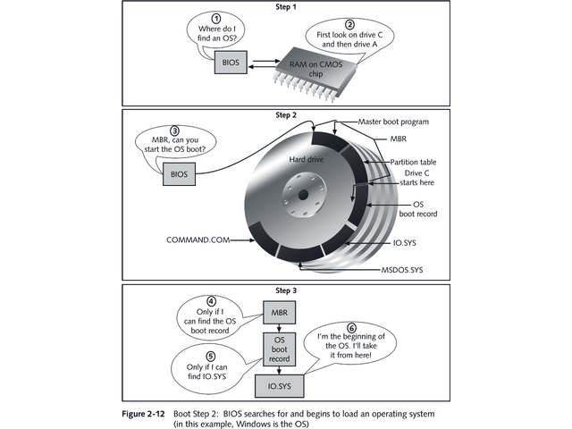
Boot Step 2

Slide 85
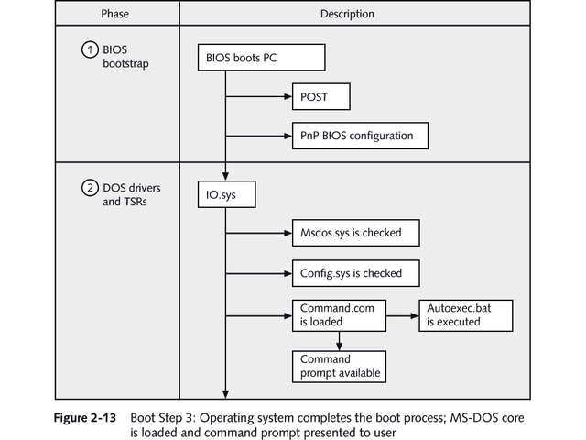
Boot Step 3

Slide 86
Booting and ROM
System such as cellular phones, PDAs and game consoles stores entire OS on ROM. Done only for small OS, simple supporting hardware, and rugged operation.
Changing bootstrap code would require changing ROM chips.
EPROM – Erasable Programmable ROM.
Code execution in ROM is slower. Copied to RAM for faster execution.

Slide 87
Networking Basics-OSI Layers
Seven Layer Model
1. Physical
2. Data Link
3. Network
4. Transport
5. Session
6. Presentation
7. Application

Slide 88
OSI Layers
Physical Layer
Deals With the Physical Connection Between the computers.
Provides specifications for building a physical infrastructure of a network …… TOPOLOGY
Physical Topologies
Bus
Ring
Star
Extended Star
Mesh
Hybrid

Slide 89
Star Topology

Slide 90
Star Topology‏
Like the spokes of a wheel
Centre point is a Hub
Segments meet at the Hub
Each device needs its own cable to the Hub
Predominant type of topology
Easy to maintain and expand

Slide 91
Star Topology ‏
Advantages
Easy to add devices as the network expands
One cable failure does not bring down the entire network (resilience)‏
Hub provides centralised management
Easy to find device and cable problems
Can be upgraded to faster speeds
Lots of support as it is the most used
Disadvantages
A star network requires more cable than a ring or bus network
Failure of the central hub can bring down the entire network
Costs are higher (installation and equipment) than for most bus networks

Slide 92
OSI Layers
Data Link Layer
The Data link layer ensures the data delivery between the two nodes.
In LAN these are two endpoints of a communication process.
In WAN these are two neighbor devices which are part of a communication process.
The format of the data at this layer is known as frames.
The Data Link Layer also handles the data transmission on network media.
This is very much important when the network media is shared between the network nodes.
The sub layer of data link called Media Access Control (MAC) uses a method to achieve this task.
This method is known as Carrier Sense Multiple Access (CSMA).

Slide 93
OSI Layers
With CSMA, each node before transmitting a frame on the network senses the carrier, if it is unused then the frame is transmitted over the network, else the device waits for some time and the above process is repeated.
The Data Link layer also performs error detection and correction methods.
However most of the technologies only use error detection method.
To help detect errors, a source device that creates a frame, calculates a Frame Check Sequence value by using an algorithm and appends it to the frame and sends it on the network.
The device that receives it also performs the same procedure to calculate the Frame Check Sequence value and matches it with value sent by the sender device.
If the value matches means the frame has no errors, however if the value does not match means the frame is damaged and will be dropped.

Slide 94
OSI Layers
Network Layer
The Network Layer introduces a Logical Address scheme.
This Address scheme allows you to divide your single large physical segment into smaller logical groups called networks.
This helps improve the performance of the network.
As these networks can not directly communicate with each other, this layer also provides mechanism to achieve this.
A device called router is used for the internetwork communication.
Thus a device will have two addresses – A network layer address and data link layer address.

Slide 95
OSI Layers
Transport Layer
As the packets may get lost during their travel from source device to destination device, something has to take care of this to make the data transfer reliable.
The transport layer provides this service to all the upper layer protocols of the OSI model.
Session Layer
The session layer controls the communication between the two devices.
It provides tools and mechanisms by which the two communicating devices can synchronize the session.

Slide 96
OSI Layers
Presentation Layer
The presentation layer deals with the form in which information transmitted through the network is represented, without changing its contents.
Because of this layer, information transmitted by the application layer of one system is always understandable to the application layer of another system.
This layer also introduces data security mechanisms like encryption to make sure data transmissions on any type of network are secure.
Application Layer
The application layer is really a set of several protocols that network users can use to access shared network resources, such as files, emails and Web pages.

Slide 97
TCP / IP Model
The TCP/IP model was developed at the initiative of the U.S. Department of Defense more than 20 years ago to ensure connectivity between the experimental ARPANET network and other networks.
TCP/IP was implemented as a protocol suite for a heterogeneous network environment.
The University of California at Berkeley has brought the greatest contribution to development of the TCP/IP stack.
The TCP / IP model has four Layers.
The Physical layer of the TCP/IP is responsible only for organizing an interaction to network technologies,

Slide 98
TCP / IP Model
The task of providing interface between TCP/IP technology and any other technology of the intermediate network is reduced to the following tasks:
Defining the method of encapsulating an IP packet in the PDU of the intermediate network
Determining the method of translating network addresses into addresses adopted by the technology used by this intermediate network
The Network Layer introduces Addressing using IP protocol.
It allows you to create different IP subnets.
It also introduces mechanisms that allows packet forwarding between these subnets.
There are various protocols that work at network layer along with IP like RIP, OSPF, ICMP, IGMP etc.

Slide 99
TCP / IP Model
The Transport Layer
The transport layer of the TCP/IP stack provides the following two types of services to the upper layer
Guaranteed delivery by means of the Transmission Control Protocol (TCP)
And Best effort delivery using User Datagram Protocol (UDP)
The functions of Transport Layer include the role of a link between the application layer and the underlying internet layer.
The transport layer takes the job of data transmission with the specified quality from the application layer and informs it after accomplishing this task.

Slide 100
TCP / IP Model
The Application Layer
It combines the services provided by the system to user applications.
It performs the functions of the upper three layers of the OSI Model- Session, Presentation and Application.
It contains protocols like http, ftp, smtp, telnet etc.

Slide 101
Overview of Transmission Media

Slide 102
Overview of Transmission Media
In a data transmission system, the transmission medium is the physical path between transmitter device and receiver device.
Two categories of transmission media used in computer networks.
Guided / Bounded
Unguided / Unbounded
Guided or Bounded media are the physical links through which the signals are guided along a solid medium.
Guided or Bounded media are great because they offer high speed, good security and low cast.
However, some time they cannot be used due to distance constrains.

Slide 103
Overview of Transmission Media
Three common types of bounded media are used for the data transmission. These are
Coaxial Cable
Twisted Pairs Cable
Fiber Optics Cable
The unguided or unbounded media is used by the wireless communication.

Slide 104
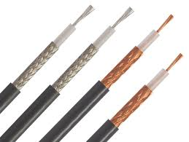
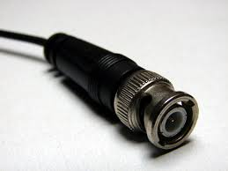
Overview of Transmission Media
Co-Axial Cable-
The coaxial cable consists of a solid copper core.
The copper core is surrounded by a special insulator.
A woven copper mesh shielding layer surrounds the insulator.
Final outside insulation layer shields all inner layers.
The copper wire mesh is connected to the device ground.
This mesh taps any electrical noise due to EMI and protects the inner conductor.
The coaxial cable provides better resistant to interference and attenuation than twisted pair cabling.It transmits voice, video, and data.
BNC Connector

Slide 105
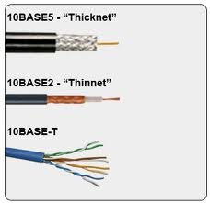
Overview of Transmission Media
Co-Axial Cable
Coaxial cable is widely used as a means of distributing TV signals to individual homes—cable TV
Two types of coaxial cables- Thin and Thick.
The Thin coaxial network also referred to as 10Base2.
The Thick coaxial network is referred to as 10Base5.

Slide 106
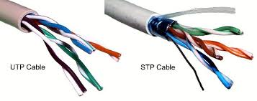
Overview of Transmission Media
Twisted Pair
This network cable type consists of a number of copper wire twisted around each other.
The Copper strands are insulated using insulating material.
The twisting cancels out electrical noise from adjacent pairs and from other electrical sources.

Slide 107
Overview of Transmission Media
Twisted Pair
These cables are used in telephone and computer networks.
The total number of pairs in a cable varies according to its use.
The cables used in telephone networks have more pairs.
The cable used in computer network usually has 4 pairs.

Slide 108
Overview of Transmission Media
Twisted Pair
Two types of twisted pair cables.
Unshielded Twisted Pair (UTP)
Shielded Twisted Pair (STP)
These pairs of wires are typically color-coded to distinguish them.
The maximum cable length segment is 100 meter(nearly 328 feet).
If you exceed this segment length limitation, attenuation occurs.
Attenuation is the gradual loss of signal strength as it moves farther from the point of origin.

Slide 109
Overview of Transmission Media
Twisted Pair
Two types of twisted pair cables.
Unshielded Twisted Pair (UTP)
Shielded Twisted Pair (STP)
UTP is susceptible to Electro Magnetic Interference (EMI or crosstalk).
STP uses a higher quality protective jacket and also uses foil wrap between and around the wire pairs.
Thus STP is less susceptible to interference and supports higher transmission rates than UTP.

Slide 110
Overview of Transmission Media
Twisted Pair
These pairs of wires are typically color-coded to distinguish them.
The maximum cable length segment is 100 meter(nearly 328 feet).
If you exceed this segment length limitation, attenuation occurs.
Attenuation is the gradual loss of signal strength as it moves farther from the point of origin.

Slide 111
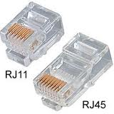
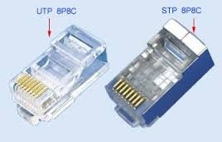
Overview of Transmission Media
Twisted Pair
In telephone networks UTP/STP cables are terminated using a 4 to 6 pin RJ-11 connector
In computer networks UTP/STP cables are terminated using a 8-pin RJ-45 connector.
RJ stands for Registered Jack.
Registered jacks were created by industry and regulated by the FCC to be the standard interface between a telephone company and a customer.
RJ-45 Jack

Slide 112
Overview of Transmission Media
Twisted Pair – Categories
ANSI/EIA (American National Standards Institute/Electronic Industries Association) Standard 568 is one of several standards that specify "categories" of twisted pair cabling systems.
CAT 1
Used in Voice networks and ISDN networks
Supports up to 1 Mbps data rates
CAT 2
Mostly used in IBM token ring networks
Supports up to 4 Mbps data rates

Slide 113
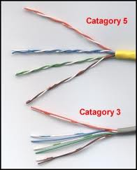
Overview of Transmission Media
Twisted Pair – Categories
CAT 3
Used mostly in voice networks.
Later used in 10Base-T Ethernet networks
Supports up to 16 Mbps data rates
CAT 4
Was used in token ring networks
Supports up to 16 Mbps data rates
CAT 5
Was used in various networks like 10/100Base-T, 4/16 Mbps token ring, 155 Mbps ATM etc.
Works at 100 MHz

Slide 114
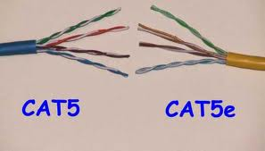
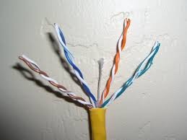
Overview of Transmission Media
Twisted Pair – Categories
CAT 5 E
used in various networks like, Gigabit Ethernet, 155 Mbps ATM etc.
Works at 100 MHz
Better prone to EMI or crosstalk that CAT 5
CAT 6
According to TIA-942, minimum requirement for data centers.
Works up to 250 MHz
CAT 6E
According to ISO data center standard, minimum requirement for data centers.
Works up to 500 MHz
Supports for 10 Gigabit Ethernet
CAT 6

Slide 115
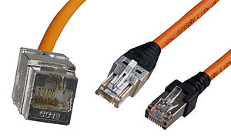
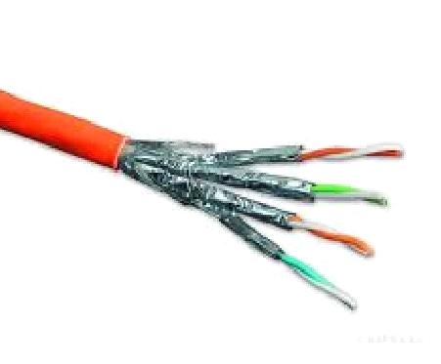
Overview of Transmission Media
Twisted Pair – Categories
Class F or CAT 7
CAT 7 Cable
GG 45 Connector

Slide 116
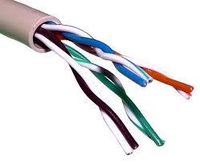
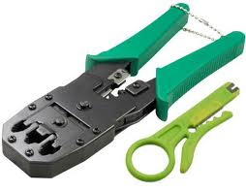
Overview of Transmission Media
Twisted Pair – Connections
UTP/STP cable contains 4 Pairs i.e. 8 cores.
The 4 pairs are identified by using 4 colors.
Each pair contains a color wire and a white wire with dots of the same color.
These cables are terminated using RJ-45 connector.
A crimping tool is used to terminate UTP/STP cables.
Crimping
Tool

Slide 117
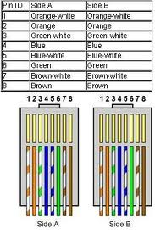
Overview of Transmission Media
Twisted Pair – Connections
Straight Cable
Straight-through cable is used to connect computers and other end-user devices (e.g., printers, NAS) to networking devices such as hubs and switches.
It can also be used to directly connect like devices (e.g., two hubs or two switches) if the cable is plugged into an uplink port on one (but not both) of the devices.

Slide 118
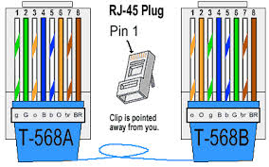
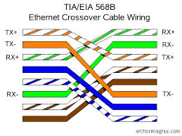
Overview of Transmission Media
Twisted Pair – Connections
Crossover Cable
Crossover cable is similar to the straight cable except in the cross cable the wires on the cable are crossed over so that the receive signal pins on the connector on one end are connected to the transmit signal pins on the connector on the other end.
Crossover cable is used to connect two like devices without the use of an uplink port.

Slide 119
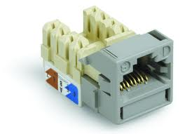
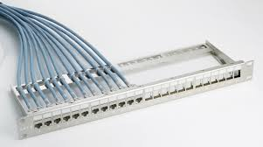
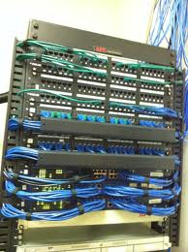
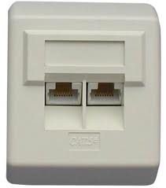
Overview of Transmission Media
Twisted Pair Cable – Other Components
Patch Panel
Information Outlet
Face Plate
Network Rack

Slide 120
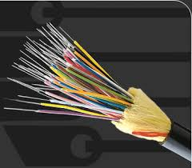
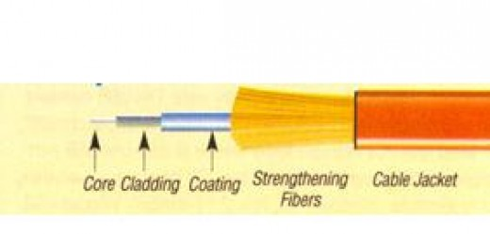
Overview of Transmission Media
Fiber Optic Cable
An optic fiber cable consists of an extremely thin cylinder of glass or plastic called the core
The core is surrounded by a concentric layer of glass called a cladding.
Optical fiber carries digital signals in the form of Light.
It does not use electricity, except to power the transmitting and receiving devices.

Slide 121
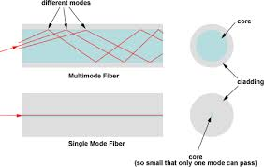
Overview of Transmission Media
Fiber Optic Cable – Types
Multi-mode and Single-Mode
Multimode fiber optic cable core has a large diameter, that allows multiple modes of light to propagate.
Single mode fiber optic cable core has a small diameter, that allows only one mode of light to propagate.

Slide 122
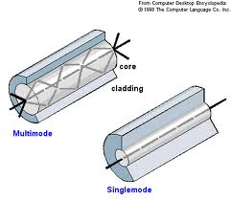
Overview of Transmission Media
Fiber Optic Cable – Types
Multi-mode and Single-Mode
In multi-mode as the light passes through the core creates more number of light reflections, thus increases the ability for more data to pass through at a given time.
In single mode the number of light reflections created as the light passes through the core decreases.

Slide 123
Overview of Transmission Media
Fiber Optic Cable – Types
Multi-mode and Single-Mode
As the Multi-mode suffers from high dispersion and attenuation rate , the quality of the signal is reduced over long distances.
Thus Multi-mode fiber is used in application like short distance communications, data and audio/video applications in LANs.
In Single mode as the light reflections are very less it lowers attenuation and creates the ability for the signal to travel faster, further.
Thus Single-Mode cable is typically used in long distance, higher bandwidth communications by Telcos, CATV companies, and Colleges and Universities.

Slide 124
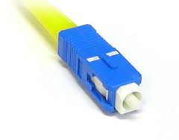
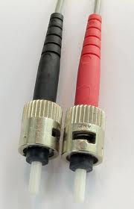
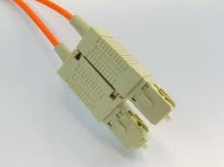
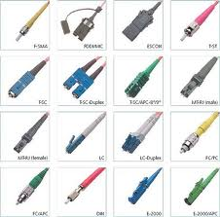
Overview of Transmission Media
Fiber Optic Cable – Other Components
ST Connectors
SC-Connector

Slide 125
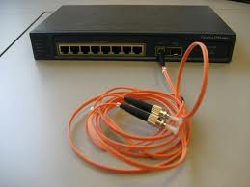
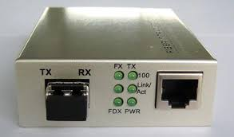
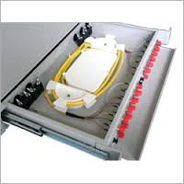
Overview of Transmission Media
Fiber Optic Cable – Other Components
Ethernet Switch
With Fiber ports
UTP to Fiber Transceiver
Light Interface Unit (LIU)

Slide 126
Module 4 Search and Seizure of Computers

Slide 127
First Responder Procedures
First responder will be the first person to visit the crime scene.
As the first responder he has an important role to be played.
He should be prepared to handle the situation and his actions should be planned.
Any action performed hurriedly or without thinking may lead to a destruction of important digital evidence.
Thus it is necessary that he has a toolkit ready and the plan to tackle the incident.
Please look the premise for all the items that may contain digital evidence like external hard disks, CD-DVD’s, Pen drives, Mobiles and Tabs, Flash cards etc.

Slide 128
First Responder Procedures
First secure the crime scene.
If physical evidences like fingerprint etc. are also important for the crime then wait for the forensics team also.
By the time secure the access to computers, peripherals and to any other electronic or electrical equipment.
This will make sure that any unauthorized person will not cause any deliberate or accidental damage to these equipments.
Photograph the entire premise and also the other equipments before you touch them or move them.
Also take the photographs of screens of equipments that are ON like computers and tabs.
Take photographs from various angles to show connections.

Slide 129
First Responder Procedures
Check the current system date and time of all gadgets including computers.
Compare the timing with a valid source.
If any discrepancies found note them down.
It is very important for the first responder to document everything properly.
If required video shooting of the premise and computers and peripherals will prove a good idea.
While documenting make sure you write the make, model , batch no., serial no. etc. details of the every device that you will search for evidence.
Take the photograph of inside of a computer to show the number of devices attached and other details.

Slide 130
First Responder Procedures
If a computer or a device is off then do not turn it on.
It may damage the digital evidence.
Also if the computer is ON do not immediately turn it OFF.
This is important as some program may be scheduled to destroy all data when the computer is turned off.
Also some times it is necessary to capture live data as digital evidence and if turn the computer off it will loose all the live data.
If you are not sure about the destructive program on a live computer try to get help of a computer expert.
If not possible make sure you do not issue shutdown command or press the power button rather just pull the power cord from the back of the computer.

Slide 131
First Responder Procedures
Stick evidence tape to secure any openings and drive bays of a computer.
Tag all the cables so that when required computer can be assembled fully as it was at the crime scene.
If you require to carry and transport the equipments out of the crime scene area make sure you do it properly.
Use anti-static bags to seal hard disks and similar devices.
Also use strong enclosures to ship these equipments.
Take care of CD and DVD’s as they are fragile.
Do not expose these equipments to radio or electro-magnetic waves.

Slide 132
First Responder Procedures
Also look for some papers diaries near computer as those may contain some username password or important filenames on that computer.
Also if you find some manuals of certain equipments seize them also as they may provide you information about the features of that equipment.
It is very important that you understand the working of any device before you start collecting any evidence.
If you handle a device without knowing it, you may unknowingly destroy or alter the data within that device.
Before you start actually collecting the digital evidence make a plan of your actions.
Do not directly work on any device specially hard disks.

Slide 133
Preparing a Forensics Checklist
Basic Checklist of necessary things that a computer forensics requires while visiting a crime scene.
Camera for video and photographic evidence
Card board / Plastic boxes for safe transportation of any electrical device with soft packing material like sponge.
Evidence inventory documents
Evidence tape
Anti-static bags
Paper evidence bags
Notepads and pens and pencils to take down any information needed and to keep a report of the crime scene
Gloves so as not to potentially damage or contaminate any physical evidence like fingerprints.
Carry all forensics software with their keys (Hardware if any).

Slide 134
Preparing a Forensics Checklist
Evidence stickers, labels or tags etc.
Crime scene tape
Permanent markers to tag items and bags.
Non-magnetic tools
Radio frequency-shielding material (to wrap communication devices in to prevent signals which potentially could corrupt, alter, damage or delete potential evidence.
Flash Light to read serial numbers on devices.
Magnifier as sometimes the serial numbers may be very small.
Carry some empty external hard disks as you may need to collect some live data.
Carry network cables, USB cables, Fire wire cables, SATA, SCSI, IDE etc. cables as you may need them at the location.

Slide 135
Preparing a Forensics Checklist
You have seized the required devices and documented them and sent them securely to forensics lab for further investigation.
However you may require some of the following information which may be useful in further investigation.
Names of all users who used the computer or the device.
All login names and user account names
Purpose and uses of devices and/or computers
All computer and device passwords
Any automated applications in use
Type of internet access
Any offsite storage

Slide 136
Preparing a Forensics Checklist
Internet service provider
IP address of the internet connection if fixed IP used.
Installed software and applications
Information about all e-mail accounts
Security software and other measures in use
Web mail account information
Data access restrictions in place (NTFS permissions etc.)
All instant messenger software's installed and used
All destructive devices or software in use
Any online social networking accounts the users have
Any other relevant information
Service provider in case of Mobile devices.

Slide 137
Working on Live Systems and Dead Systems
The main argument has always been whether to conduct Live system analysis or a Dead system analysis.
The decision entirely depends on the crime scenario.
Most of the time the analysis can be performed on the dead systems.
However when it comes to analysis of mission-critical system which can not have downtimes, there is no other alternative but to perform live analysis.
There are pro’s and con’s of both the methods.
The dead system analysis provides a substantial amount of evidences but lacks the volatile data.
The volatile data contains session information, cookies, RAM data, Live applications and services running etc.

Slide 138
Working on Live Systems and Dead Systems
The volatile data is lost when the computer is turned off.
The computer may store some of this volatile data even the computer is turned on but not all is retained.
Thus the Live system analysis always reveals more evidences as compared to the dead system analysis.
Today’s forensics tools allow you to capture entire live system which includes memory data.
However it is necessary to isolate the affected system before you start analyzing it.
If you do not properly isolate the affected system, it may affect other systems in the network and may lead to a disaster.
Either disconnect the system from network or shift to test network.

Slide 139
Working on Live Systems and Dead Systems
However the live system analysis should be done with due care as any wrong action may result in alteration or deletion of evidence.
Also before you start live system analysis it is necessary to find if any destructive program is running which may trigger on network disconnection or activating a forensics tool.
Also as in today’s systems the operating system keeps on changing the RAM data as per the operations so it is difficult to prove later that the acquired evidence was there.
Also an attacker may delete logs or other tracks when he comes to know about your forensics work.
As most of the data acquisition tools run top of the operating systems and depend on it for getting data from various locations thus if OS in infected the data you get may not be correct.

Slide 140
Module 5 Forensic Imaging and Verification

Slide 141
Imaging
Generally the forensics expert makes a digital copy of the main evidence like hard disk, pen drive etc.
It is always good to work on the digital copy of the evidence rather than working on actual evidence.
This precaution is necessary as while working, you may accidently alter or damage the actual evidence.
Also tomorrow the court may request cross verification from other party in that case the evidence requires in it’s original format as it was seized.
Also before you start working on the digital copy of the evidence, make sure that it is an exact digital replica of the original and alterations are there.
Thus the first step in forensics is to create an exact physical copy of the evidence.

Slide 142
Imaging
This copy is generally known as a bit-stream image, forensic duplicate or forensic image.
However this copy can not be just created by copying files as the forensics expert may need to recover deleted files.
Thus this copy should contain not only the data from the hard disk but the free locations (blocks) information and all other things.
Thus the second copy is created by copying a sector by sector information from the original hard disk.
However it should be insured that while doing this you do not alter the original device.
If you connect your original hard disk to windows it may make changes to the disk as it is mounted read/write.

Slide 143
Write Blockers
Write blockers are devices that allow acquisition of information on a drive without creating the possibility of accidentally damaging the drive contents.
They achieve this passing read commands through them but block write commands, hence called write blockers.
Some write-blockers allow all commands to pass from the computer to the drive except for those that are on a particular list.
Where as some blockers can specifically block the write commands and let everything else through.
Write blockers may also include drive protection which will limit the speed of a drive attached to the blocker.
There are two types of write blockers, Native and Tailgate.

Slide 144
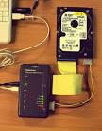
Write Blockers
A Native device uses the same interface on for both in and out, for example a SATA to SATA write block.
A Tailgate device uses one interface for one side and a different one for the other, for example a Fire wire to SCSI write block.
Steve Bress and Mark Menz invented hard drive write blocking (US Patent 6,813,682).
There are both hardware and software write blockers.
Linux systems do not require write blockers as we can mount the disk as read only.

Slide 145
Sterilizing the Forensic Media
As we know that a used hard disk even when formatted contains some data.
This residual data may cause problems in evidence gathering or in proving them later.
Thus it is a good practice to sterilize or neutralize the forensics media.
Thus first forensically wipe the hard disk that will be used to make a copy of the evidence, this makes sure that all the earlier data is removed.
Zero fill software are available that write zero’s on the entire hard disk.
You may run this routine multiple times to make sure all the earlier data is correctly wiped.
Then format the hard disk and start imaging.

Slide 146
Imaging
Once you have connected the hard disk then you start imaging the hard disk.
Make sure you use a nice tool to image the hard disk.
Various organizations like Encase provide commercial forensics toolkits that contain these utilities.
Before you start imaging make a proper documentation of all equipments used, their make and model.
For imaging software document the version and other details.
Make a note of system date and time before you start imaging.
Once you finish imaging, also make a note of system date and time so you can prove the time taken for this activity.
Also you may take a photograph or screen shot of the output on the screen .

Slide 147
Verifying Image Integrity
Once you have created an image, now you have to prove that it is an exact copy of the physical evidence.
This verification is generally done by creating a hash value of both the images and then you compare it.
Generally the MD5 hash technique can be used.
The MD5 creates a one way hash by taking an input of arbitrary length and outputs a fixed 128 bit hexadecimal number.
This output number is unique for that input.
Thus two files with the same content will create the same MD5 hash value.
Thus using this technique we make sure that the copy of the actual evidence is exactly the same.

Slide 148
Imaging
Once the image copy is verified, create some additional copies if possible.
This is necessary as you may damage or alter the image copy while performing data analysis.
Also sometimes to save time it may be required that multiple forensic expert work simultaneously to search different things.
Make sure you store all these copies securely.
Restrict access to these copies so no one else can handle them and alter them.
Keep on copy safe as you may require some additional copies during investigation.
Instead of the actual evidence hard disk use this master copy to create further copies.
This way you make sure the original evidence remains safe.

Slide 149
Module 5 & 6 Data Recovery and Analysis Investigative Techniques

Slide 150
Data Analysis
The data analysis of forensics media involves logical analysis and physical analysis.
In Logical analysis the forensic investigator uses graphical tools like file manager, file viewer etc.
Logical analysis is possible if the file system on the hard disk is intact.
The physical analysis is done by directly reading data from the hard disk physical locations.
This data presented is normally in hexadecimal format.
The investigator uses hex editors or similar tools to perform physical analysis.
Before you start any analysis you should remember that you can not search all the data as data can be very huge, thus plan what you have to search.

Slide 151
Data Analysis
Decide the search criteria first.
This will depend on the type of the crime.
If you are handling a crime related to web site hacks or email frauds then you have look for temporary Internet files.
If you are working on a financial crime then you may require to search for office documents like doc or excel files.
Hash analysis can also be performed to find the files that are different or changed.
If you have hash of known files you may compare them to find the files present on the forensics media .
This technique is useful if an employee has stored the official files on the his computer in an unauthorized manner by different names.

Slide 152
Data Analysis
The US government’s NIST keeps a hash of a large amount of files.
Also the HashKeeper site holds a hash of a good amount of files.
HashKeeper uses the MD5 file signature algorithm to establish unique hash identifiers for files "known to be good" and "known to be bad."
The HashKeeper application was developed to reduce the amount of time required to examine files on digital media.
Once an examiner defines a file as known to be good, the examiner need not repeat that analysis.
HashKeeper is available, free-of-charge, to law enforcement, military and other government agencies throughout the world.

Slide 153
Data Analysis
The second method that is used is known as Signature Analysis.
A file Signature is a header or footer within a file that indicates the type of the file.
It is also known as file magic number.
The signature for the MPEG files is
00 00 01 Bx
For Microsoft Office files the signature is
D0 CF 11 E0 A1 B1 1A E1
The Signature for the JPEG image files is
FF D8 FF

Slide 154
Data Analysis
Thus while searching the forensic media you first search using keyword criteria i.e. using filenames for search.
Second you try to search files based on their types like bmp etc.
For the internet related files the first location to search for is the temporary internet files folder.
The web based email communication will also be stored at the same location.
Whenever a user uses Windows explorer or internet explorer to access a file or a web site a trace of that activity is created.
The index.dat file contains most of these logs.
This is a binary file and is not easily viewable unless used a tool like Pasco.

Slide 155
Data Analysis
Also for tracking internet related information cookies provide a good help.
Cookies are files that are placed by the web server on the client computers.
The Cookies are of different types and their use is also different.
The session cookies are used by the web server to identify a user and his connection.
Each time a communication takes place between client computer and web server this cookie is encoded into the HTML code.
A cookies directory in user profile stores all cookies.

Slide 156
Data Analysis
On windows XP the temporary internet files are available at
Documents and settings\%Username%\Local Settings\Temporary Internet Files
Additional internet files may be cached at
Documents and settings\%Username%\ Local Settings\Temp\Temporary Internet Files or in Documents and settings\%Username%\ Local Settings\Temporary Internet Files.
On Windows 7
Users\%Username%\AppData\Local\Microsoft\Windows folder.
All these folders are hidden so make sure you enable show hidden files option.

Slide 157
Data Analysis
Outlook Express stores emails in windows at
\Documents and settings\%Username%\Local Settings\Application Data\Identities\{long number}\Microsoft\Outlook Express.
The file extension is .dbx
In Windows 7 the Microsoft Outlook stores the email files at
\Users\%username%\AppData\Local\Microsoft\Outlook\Outlook.pst
The cookies folder in windows 7 is at
\ Users\ %username%\ AppData\ Roaming\ Microsoft\ Windows”.
On windows XP it is at
C:\Documents and Settings\%username%\Cookies\

Slide 158
Data Analysis
The Log files also provide a good amount of evidence.
Every file creation activity in the operating systems is marked with a time stamp.
Thus verify the time stamps of important files.
Also some times a criminal might have deleted some data.
But as we know when you delete a file the actual data is not deleted from the hard disk.
Thus a good data recovery software will be able to recover these files.
However this is possible only if the data is not overwritten on the hard disk.
Also the success of data recovery depends on the file system.

Slide 159
Data Analysis
Whatever files you search , make sure they are related to the crime.
Sometimes it is not possible to recover the entire file, however the part of the recovered file may also contain some information.
Also look for the temporary files created by the applications like office application.
These temporary files will contain certain records related to the crime.
Sometimes it may be required to perform a physical analysis of the data.
This process required a lot of skills and pations also.

Slide 160
Data Analysis
During data analysis when you find any file related to the crime first document all the details about that file.
The details should include the name of the file, size of the file, location it was stored, file type, time stamps related to the file etc.
Copy that file to a separate clean drive.
Create a hash of that file.
Compare the original and the copied file.
Make sure you document every step of forensics procedure.
Similarly scan all other devices also.

Slide 161
Reporting
Once you have done with the investigation , next step is to create a report.
While writing the report first find out where these findings will be used.
According to the use of the report you require to create it in that specific format.
Make your report technical but simple by avoiding complicated technical terms as it may be read by people who may not be technical.
You may require to justify your findings at a later stage may be after a long period.
Thus make the report such that you will remember it.
Do not include your views in the report.

Slide 162
Reporting
Do not generate report with your biased views.
This report should just provide your findings.
Include all possible screen shots and photographs that you have taken during investigation.
Include all documentation related to tools used and date and timings etc.
If for some thing some other expert advice was taken then include all the things related to this activity.
Also include the report from that expert as it is.
Include the chain of custody document.
Make sure the report activities are as per the chain of custody document.
Include file and MD5 hashes taken at various stages.

Slide 163
Reporting
Also make sure you include only those evidences which are related to the actual crime.
Else you may tend to put each and every piece of evidence gathered and cause an Information Overload problem.
Thus it is necessary for a forensics expert to identify relevant evidence.
You may consult other authorities involved before finalizing the report just to check the proper format.
Also do not reveal your report to all except the required authorities.
If the reporting is for the personal / enterprise usage then may be once the job is over you require to destroy everything that you have.

Slide 164
Questions

